Slide 2
Enhanced Leak Localization in Headphones
Through Beamforming and 3D Modelling

Slide 3

Introduction
Image from: Jordan JamiesonMane. Sound Leakage in Headphones: What It Is and What You Can Do About It | Headphonesty. https://www.headphonesty.com/2021/04/sound leakage/.

Slide 4
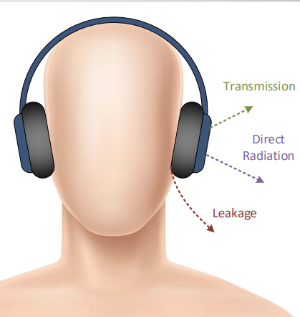
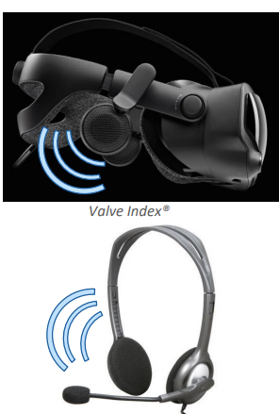
Introduction
Sound leakage or intentional radiation will:
Impact privacy of content and communication
Create noise in calm environment like workspace or library
Give undesired feedback to recording microphone (echo)
Disturbing the input microphone in Active Noise Reduction (ANC) devices
Image from: 2019 AES Conference on Headphone Technology - Workshop on 3D Directivity

Slide 5
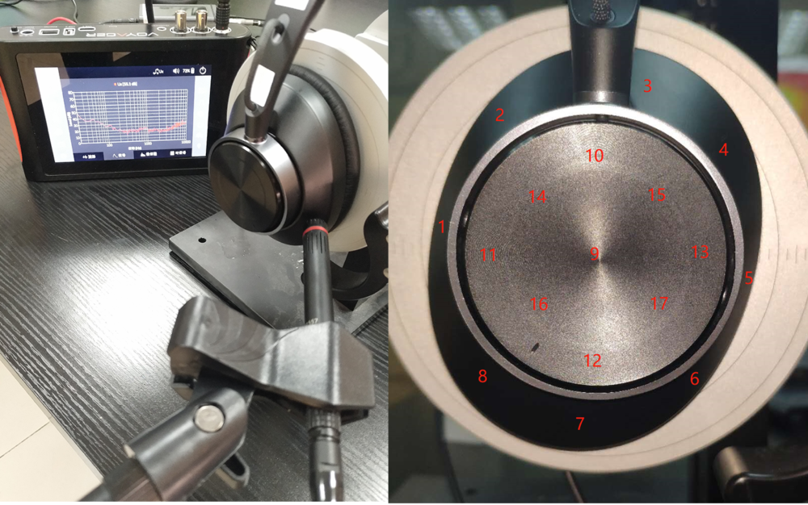
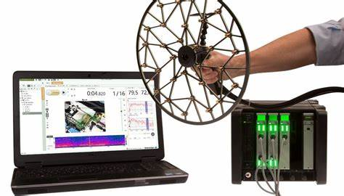
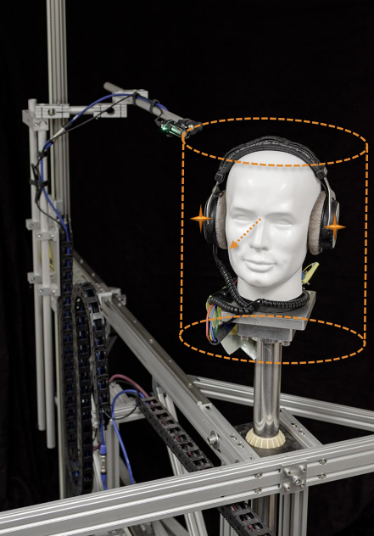
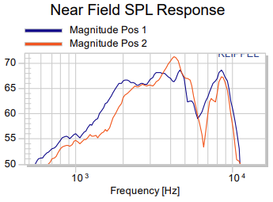
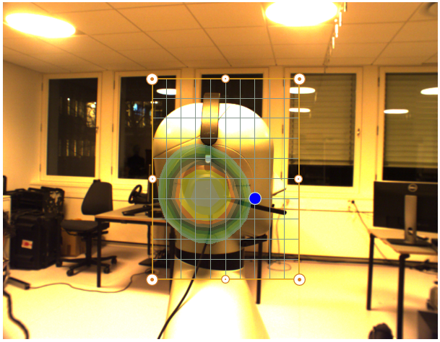
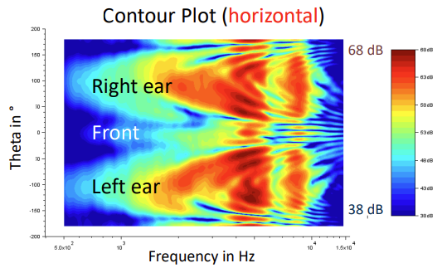
Motivation
PULSE Array-based Noise Source Identification Solutions:
Beamforming Type 8608, Acoustic Holography Type 8607 and
Spherical Beamforming Type 8606
Meng, Fanyu, Anbo Yu, and Dani Fernandez. "Sound leakage investigation of ANC headphones using particle velocity sensors." INTER-NOISE and NOISE-CON Congress and Conference Proceedings. Vol. 261. No. 6. Institute of Noise Control Engineering, 2020.
Workshop 3d Directivity Data in Headsets and Hearables - R.Werner (KLIPPEL GmbH) - online

Slide 6
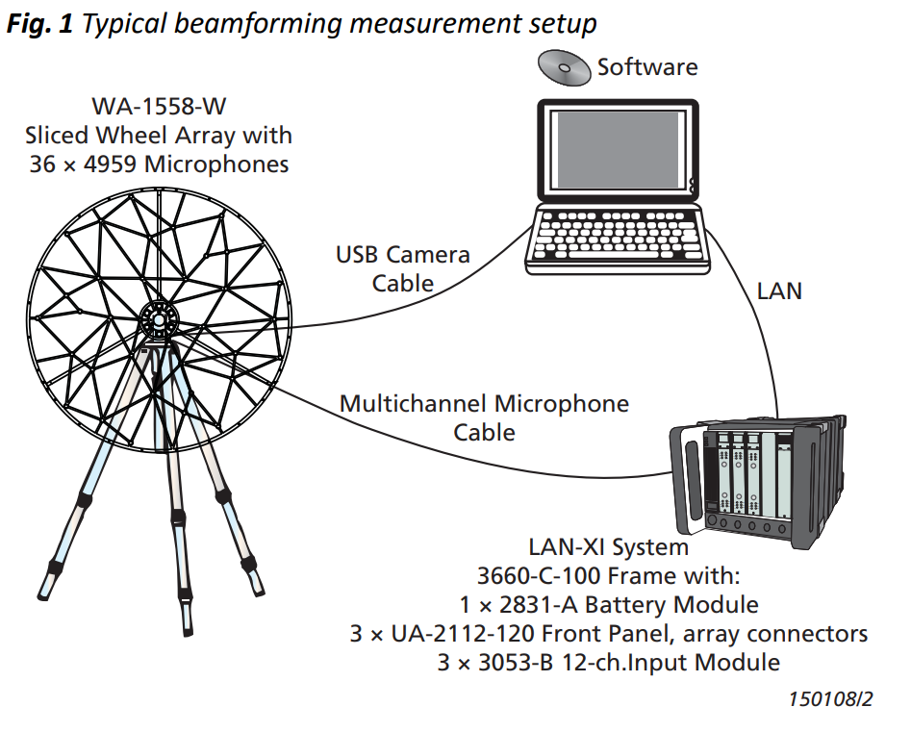
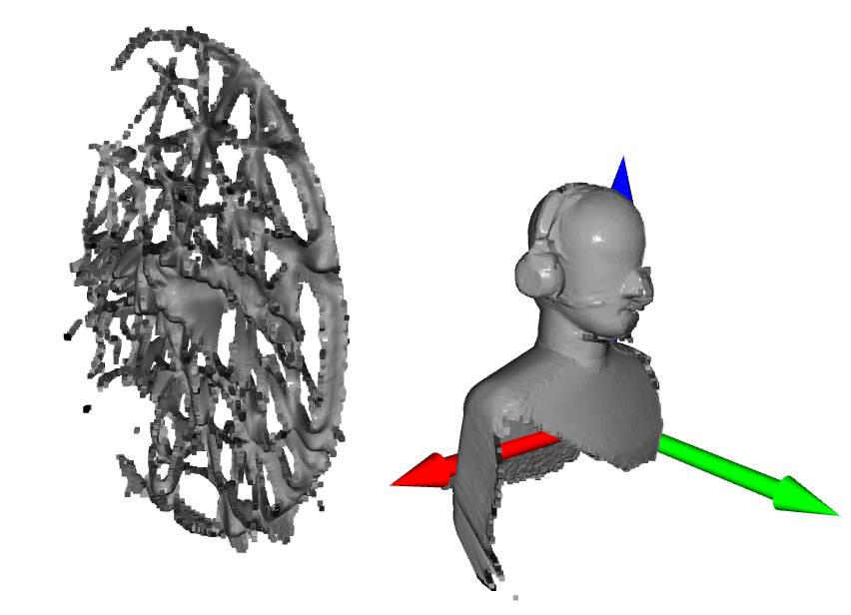
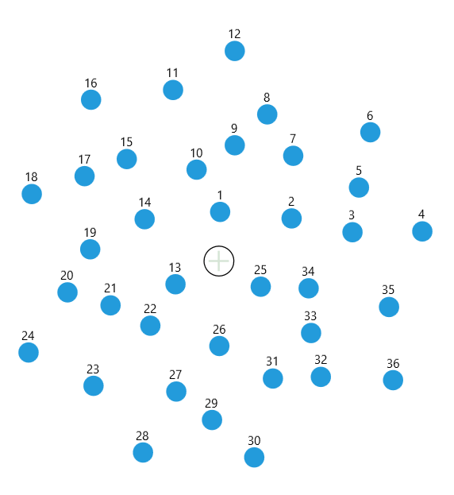
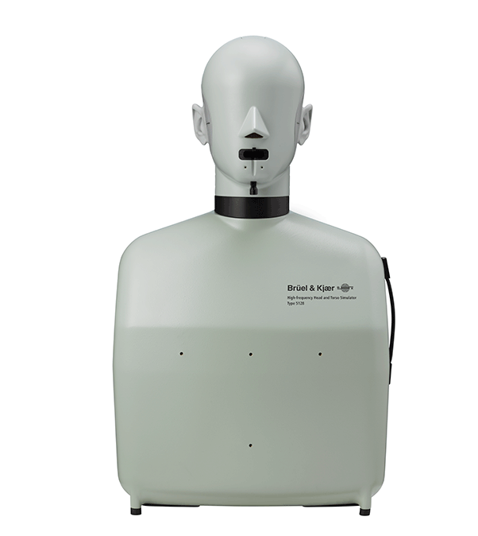
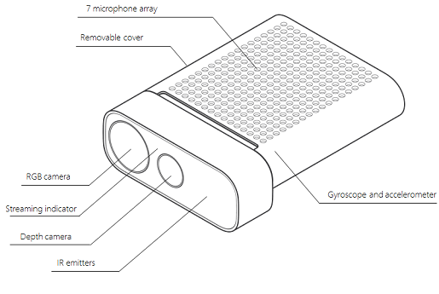
Measurement devices
Image from: Product Data: PULSE Array Acoustics, Refined Beamforming Calculations BZ-5639 (BP-2543)
Example of scanning result
B&K 36 channel sliced wheel arrays:
Diameter: 0.45m
Average microphone spacing: 0.066m
B&K Head and Torso Simulator (HATS) Type 5128
With the Type 4620 ear simulator
Azure Kinect Developer Kit

Slide 7
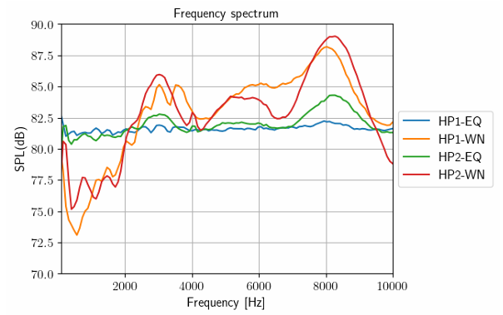
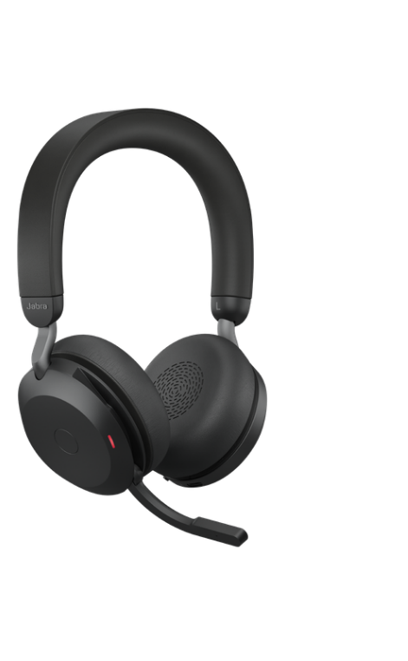
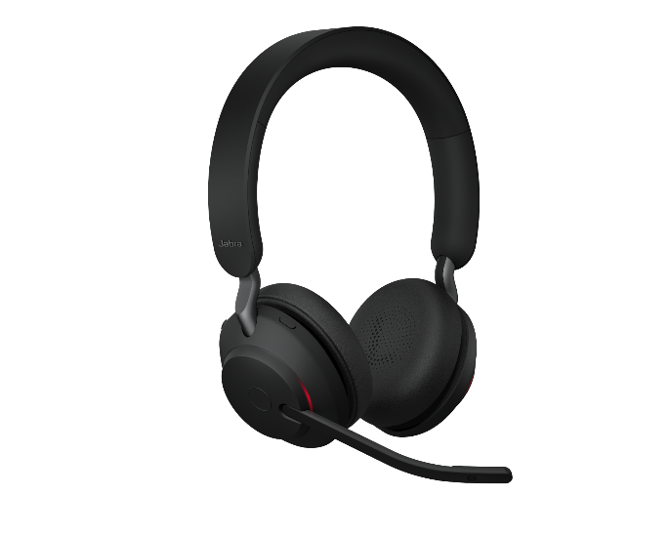
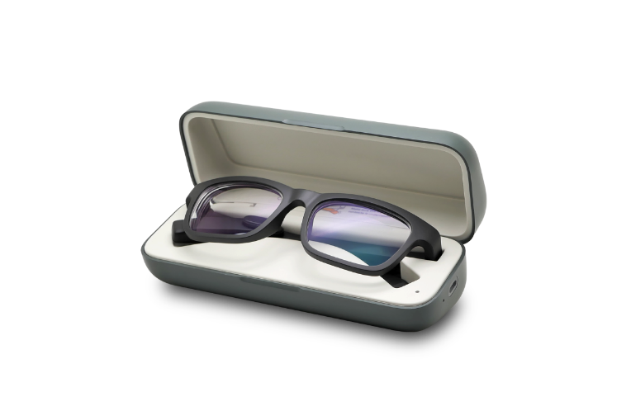
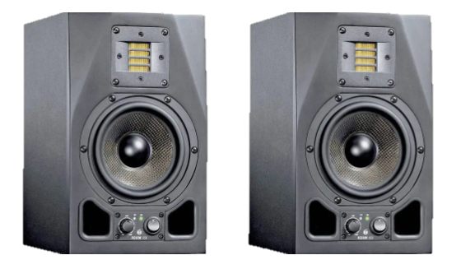
Device under test
Jabra Evolve2 75 (HP1)
Jabra Evolve2 65 (HP2)
Adam A5x
Vue Smart Glasses
Drived by pc through Bluetooth play equalized white noise, same SPL from in ear microphone
Drived by Lan-XI frontend with un-correlated white noise
Drived by pc through Bluetooth play white noise

Slide 8
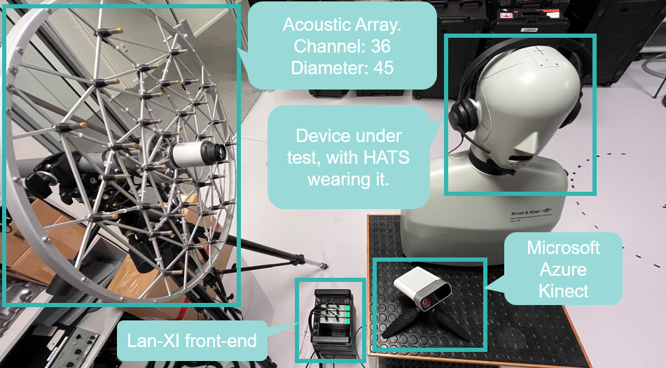
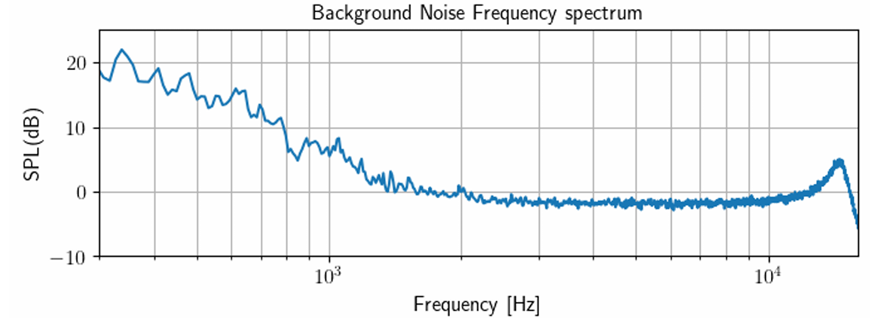
Lab Environment

Slide 9
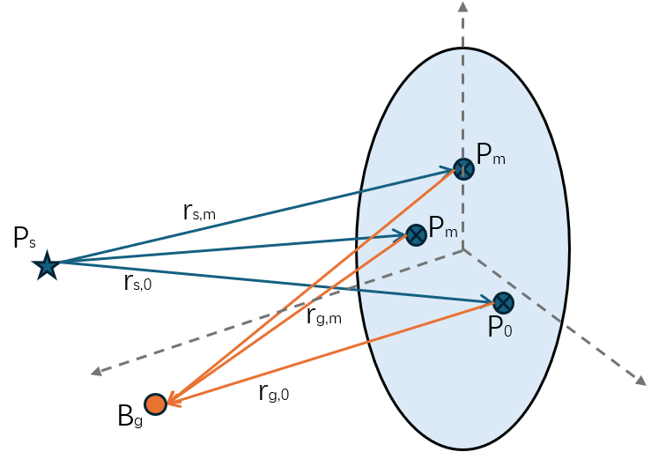
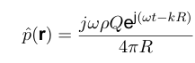
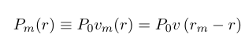
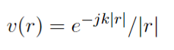
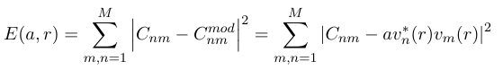
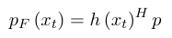
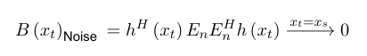
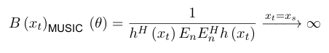
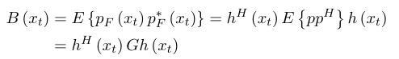
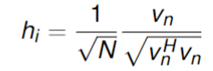
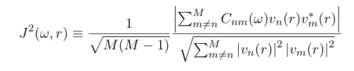
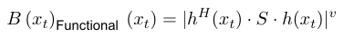
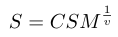
Theory
Sound pressure from a point source:
At microphone m:
Error function:
Reversely calculate the field point:
Multiple Signal Classification (MUSIC) Beamforming:
Take the Cross-spectrum matrix of the field point result:
Normalized steering vector:
Image function with diagonal removal:
Functional Beamforming

Slide 10
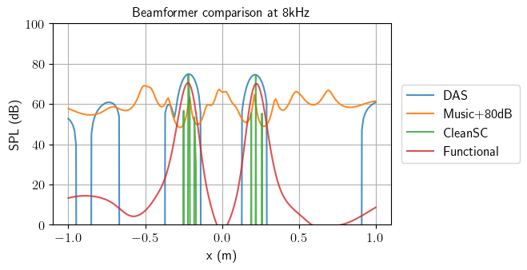
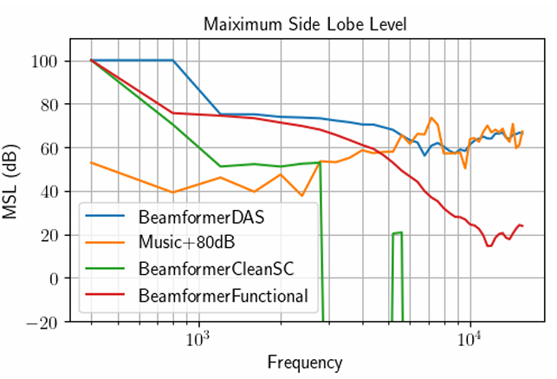
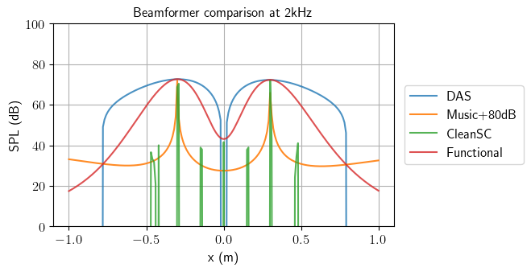
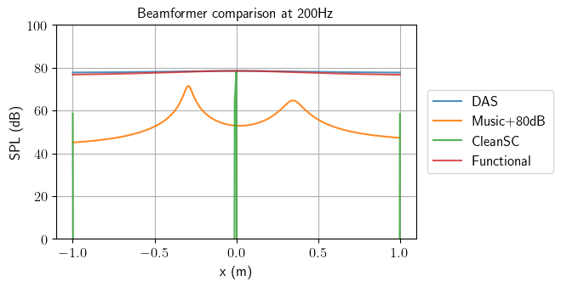
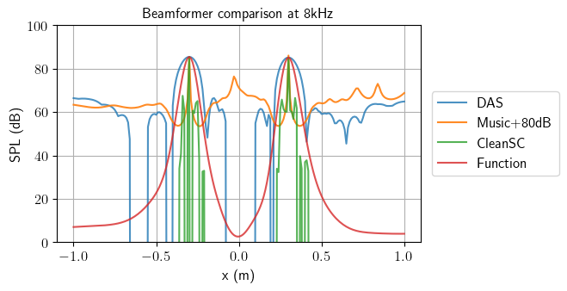
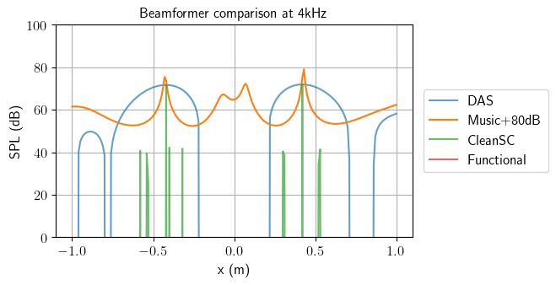
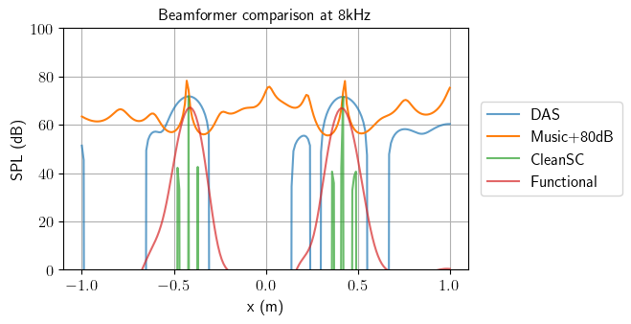
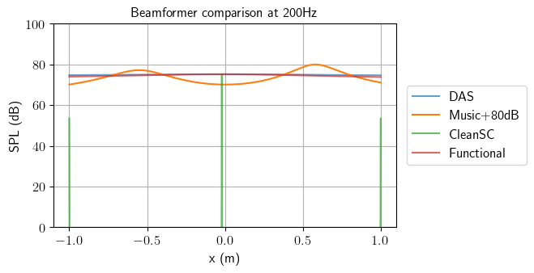
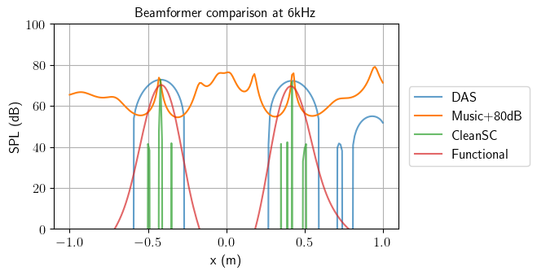
Verification – beamformers performance
Source:
Two un-correlated source with white noise in 1pa rms (90dB SPL)
At (0.3m, 0.7m), (-0.3m, 0.7m)
Line grid:
Located 0.7m from array
Grid points distance 0.01m
Beamformer MUSIC is targeting to the noise instead of the source, so its resolution is not limited by the mainlobe width
Line grid at 1m

Slide 11
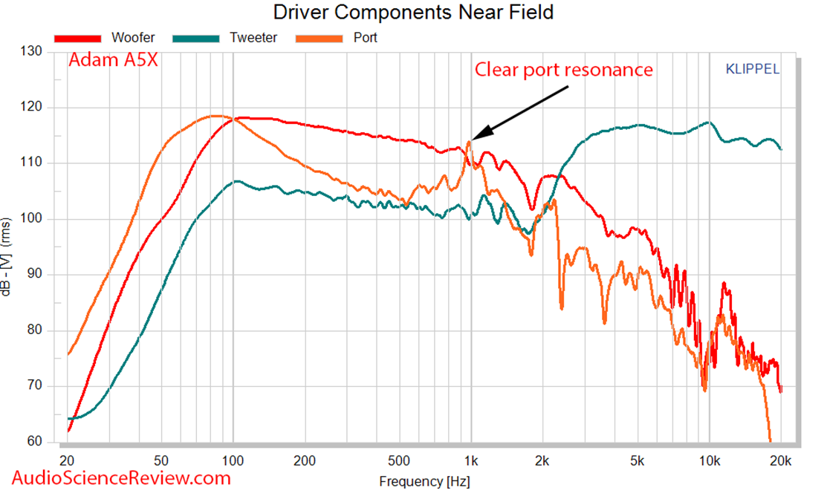
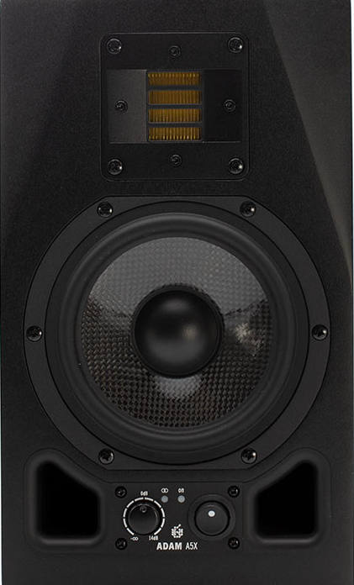
Verification – Adam A5x single box

Slide 12
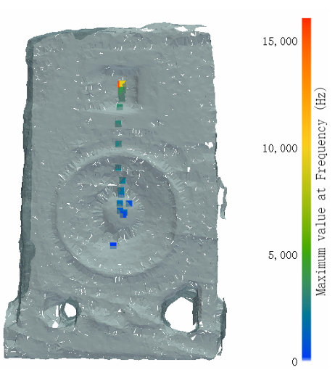
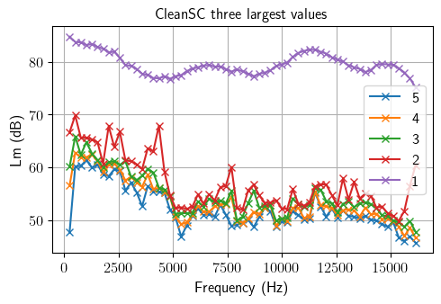
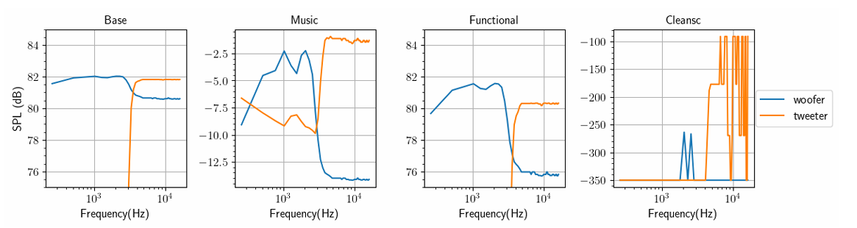
Verification – Adam A5x single box
5 largest value from CleanSC
As Frequency response
The largest value from CleanSC
As Location response
Reconstructed SPL at Woofer and Tweeter location

Slide 13
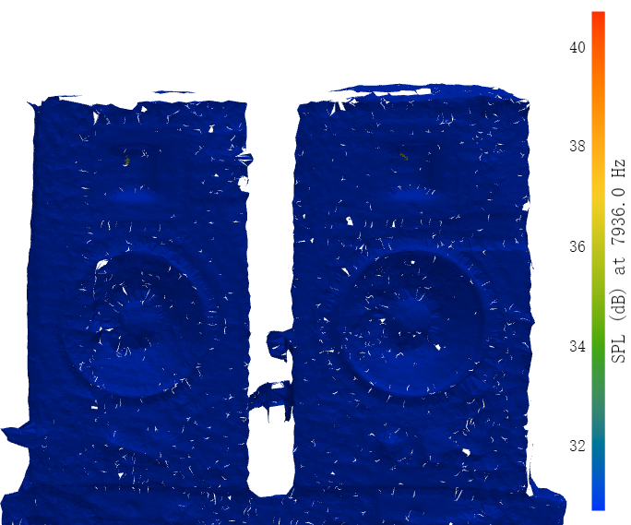
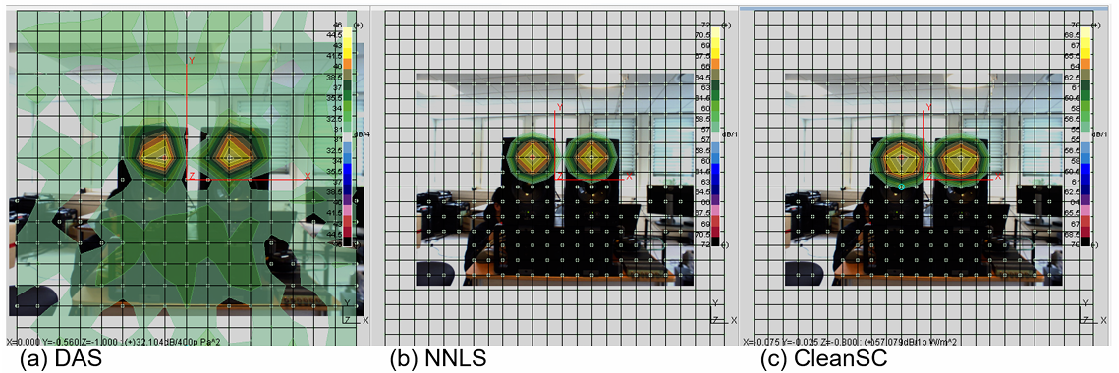
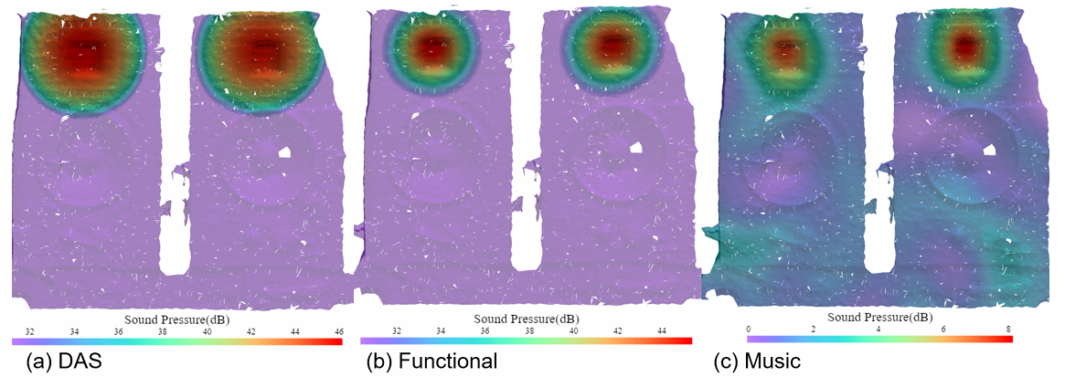
Verification – Adam A5x two box
B&K Pulse Noise Source Identification (NSI) 2d array acoustic beamforming results
3d beamforming results
Both results are under 8000Hz, 1/3 octave bandwidth, and 15 dB dynamic range

Slide 14

Verification – Adam A5x two box

Slide 15


Array Alignment
Step1: Manual point cloud registration
Step2: Array calibration with Functional Beamformer result
Beeper play 1/3 Octave white noise centered at 8kHz
In above case, array movement: x +0.01m, y+0.03m

Slide 16



Results – Jabra Evolve2 75
Functional Beamformer result
Three largest value from CleanSC
Frequency response
Three largest value from CleanSC
Location response

Slide 17






Results – Vue smart glasses
Bone conduction vibrator

Slide 18


Results – Jabra Evolve2 65

Slide 19

Results – Jabra Evolve2 65

Slide 20





Results – Simulated Radiation pattern
Jabra Evolve2 65 – foam front
Vue Smart Glasses
Jabra Evolve2 65
Jabra Evolve2 75

Slide 21








Results – Klippel Scanning example
Simulation results TO Jabra Evolve2 65
Results from: 2019 AES Conference on Headphone Technology - Workshop on 3D Directivity

Slide 22
Conclusion

Slide 23



Results – Simulated Radiation pattern
Vue Smart Glasses 5 largest values
Adam A5x 5 largest values
Jabra Evolve2 75 5 largest values

